Slide 1
CSC-257 Theory Of Computation (BSc CSIT, TU)
Ganesh Khatri
kh6ganesh@gmail.com

Slide 2
Instantaneous Description of PDA (ID)
Instantaneous Description(ID) of a PDA is an informal notation of how a PDA “computes” a input string and makes a decision that string is accepted or rejected.
A ID is a triple (q, w, α), where :
q – current State
w – Remaining Input
α – Stack Content

Slide 3
Instantaneous Description of PDA (ID)
⊢ sign is called a “turnstile notation”(right tack) and represents one move.
⊢* sign represents a sequence of moves
Eg : (p, b, T) ⊢ (q, w, α). This implies that while taking a transition from state p to state q, the input symbol ‘b’ is consumed, and the top of the stack ‘T’ is replaced by a new string ‘α’

Slide 4
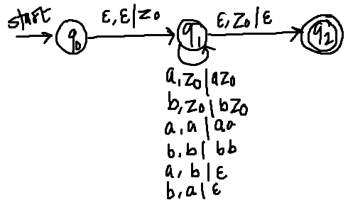
Instantaneous Description of PDA (ID)
For the PDA described earlier accepting language of equal a’s and b’s, the accepting sequence of ID’s for string baab can be shown as :
(q₀, baab, Є ) ⊢ (q₁, baab, z₀)
⊢ (q₁, aab, bz₀)
⊢ (q₁, ab, z₀)
⊢ (q₁, b, az₀)
⊢ (q₁, Є, z₀)
⊢ (q₂, Є , Є ) Accepted
Therefore, (q₀, baab, z₀) ⊢* (q₂, Є, Є)

Slide 5
Language of a PDA
We can define acceptance of any string by a PDA in two ways :
Acceptance by final state : Given a PDA P, the language accepted by final state, L(P) is - {w | (p, w, z₀) ⊢* (q, Є, γ)} where q ε F and γ ε Г*
Acceptance by empty stack : Given a PDA P, the language accepted by empty stack, L(P), is - {w | (p, w, z₀) ⊢* (q, Є, Є)} where q ε Q.

Slide 6
Deterministic Pushdown Automata (DPDA)
While the PDAs are by definition, allowed to be Non-deterministic, the deterministic PDA is quite important.
In practice, the parsers generally behave like Deterministic PDA, so the class of language accepted by these PDAs are practically important.
DPDA are suitable for use in programming languages.
A deterministic PDA is one in which there is exactly one choice of action for a given state, input symbol and stack symbol

Slide 7
Deterministic Pushdown Automata (DPDA)
A pushdown automata P = (Q, Σ, Г, δ, q₀, z₀, F) is DPDA if there is no configuration for which P has a choice of more than one moves. i.e. P is deterministic if following two conditions are satisfied :
For any q ε Q, x ε Г, If δ(q, a, x) ≠ Φ for some a ε Σ then δ(q, Є, x) = Φ. i.e. if δ(q, a, x) is non-empty for some a, then δ(q, Є, x) must be empty.
For any q ε Q, a ε Σ U {Є} and x ε Г, δ(q, a, x) has at most one element
Example :

Slide 8
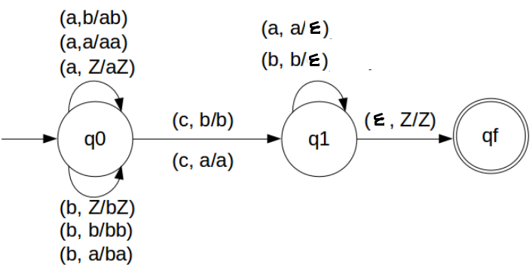
Deterministic Pushdown Automata (DPDA)
Example : A DPDA accepting language L = {w c w^{R} | w ε (a+b)+}

Slide 9
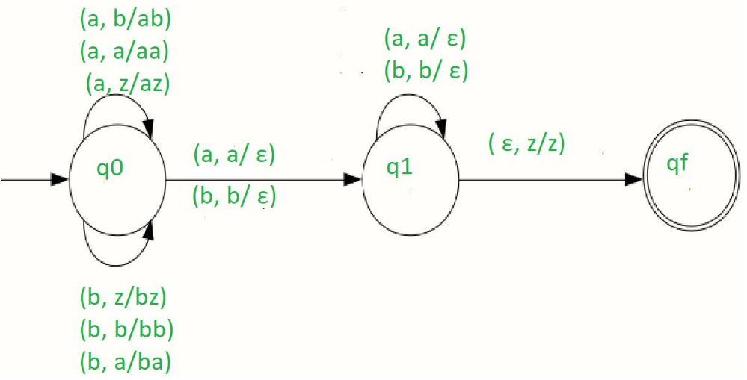
Non - Deterministic Pushdown Automata (NPDA)
Example : A NPDA accepting language L = {ww^{R} | w ε (a+b)+}

